Slide 1
Plastic Formulation of Rate-and-State Friction and Semi-Brittle Rheology
Fast and Slow Earthquakes at Megathrust:
Xinyue Tong
PhD Student at UT Austin

Slide 2
Outline
What is Rate and State Dependent Friction
Effects of Subducted Seamounts on Megathrust
Background: Subduction Zone Fast and slow EQs
2D Implementation and Test

Slide 3
Stick-Slip
τ=μσ
Applied force > Shear Stress (μ=μ_{s})
Reduction of the friction to the dynamic friction (μ=μ_{d})
A sudden jump in the velocity of the movement
μ_{s} and μ_{d} are constants
[Brace and Byerlee 1966, Byerlee 1970]
Notes:
Realistic faults require a more complex frictional behavior. More complex frictional behavior is, in fact, observed in laboratory experiments, and these second-order frictional effects may control much of fault behavior in the Earth.

Slide 4
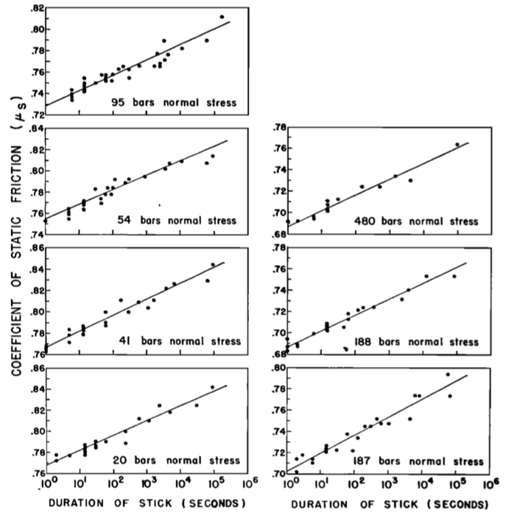
Time of Stick Dependent
Dieterich 1972 & 1978
Notes:
Static friction is not constant, but depends on the history of slip on the interface, with friction increasing as the logarithm of time of stationary contact in laboratory experiments. 90% quartz sandstone. A = 0.016, B ~ 1.0, and μ₀ = 0.7- 0.8
The time-dependent effects may be easily masked, Because the magnitude of the time-dependent effect is small compared to both the uncontrolled variability of μ between stick-slip events (μs to μd) and the often observed overall increase in μ with displacement (rate-dependent).

Slide 5
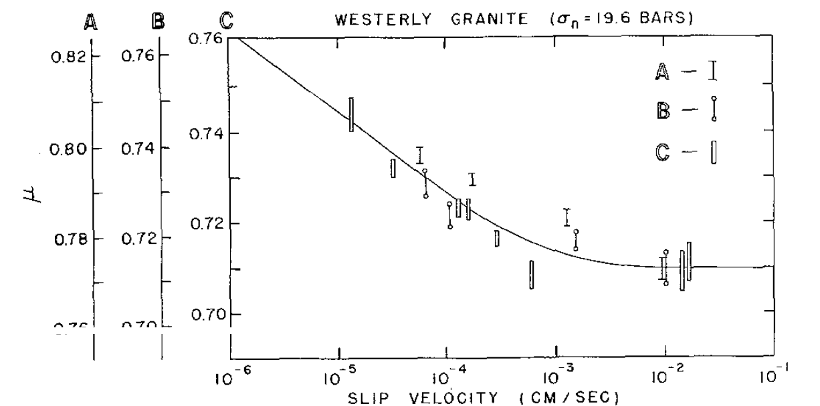
Velocity (Rate)Dependent
(Scholz and Engelder 1976, Dieterich 1978)

Slide 6
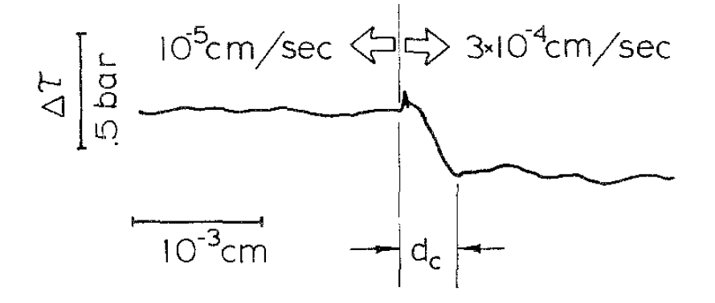
Rate and State Dependent
(Scholz and Engelder 1976)
d_{c} ~ distance to reset friction state
(Dieterich 1978)
Notes:
dc = 5e-4 cm; no velocity or stress dependence was found. However, dc was found to be sensitive to surface roughness
These observations suggest a model for sliding friction in which the resistance to slip results from two competing processes. First, the points of contact between asperities tend to become stronger with age because of creep-induced increases in area of contact (i.e. equation (2)). Second, displacement causes the destruction of old and hence strong points of contact which are then replaced with new and consequently weaker points.

Slide 7
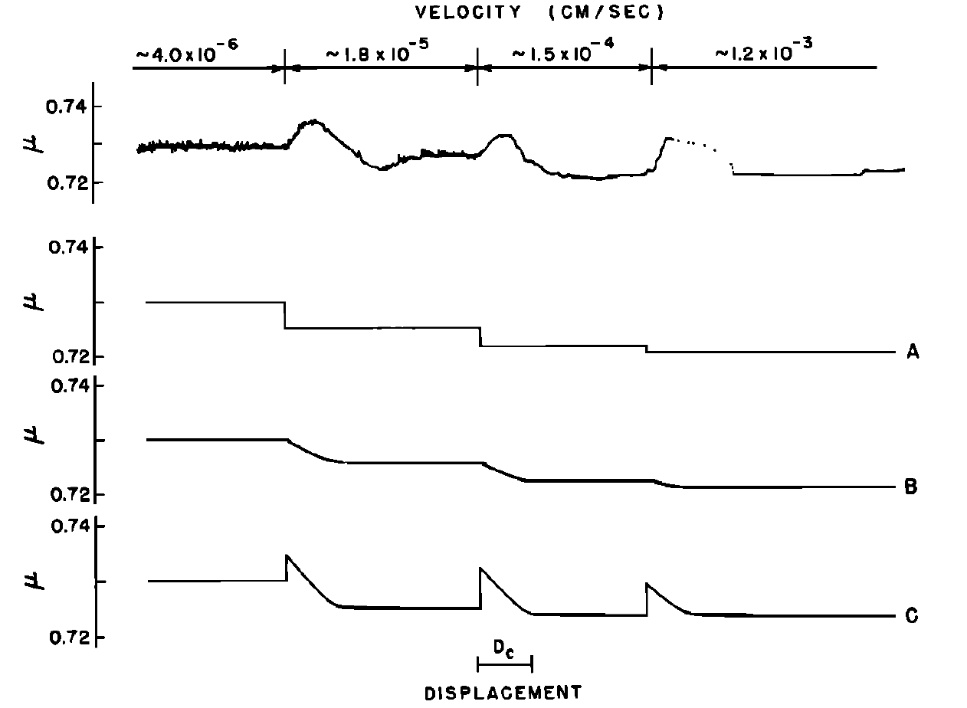
Constitutive Law --- Dieterich (1979)
μ = C(t)F(v)
t = d_{c}/v and C(t)=c₁+c₂log(c₃t+1)
t = d_{c}/v(v/d_{c})^(exp[(x₀-x)/d_{c}]
F=f₁+1/(f₂log[(f₃/v)+10
Notes:
Comparisono f experimentalr esultsf rom Figure I with empiricalf riction laws.C urve A employs( 3) and (8), with c•f' = 0.72, c,F = 0.005, and ca= 0.1. Curve B employs( 8) and (9). Curve C employs( 9) and (ll), with de = 2 X l0 -3 cm, c• = 0.69, c,. = 0.010, c3 = 0.5, f• = 1.0, f,. = 25., and f3 = 2 X l0 -3cm.

Slide 8
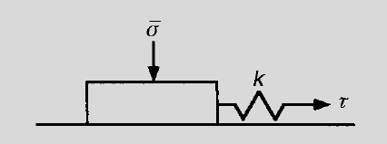
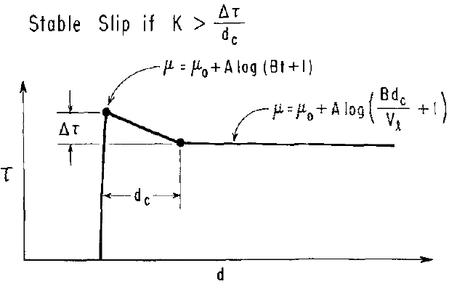
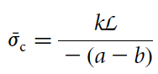
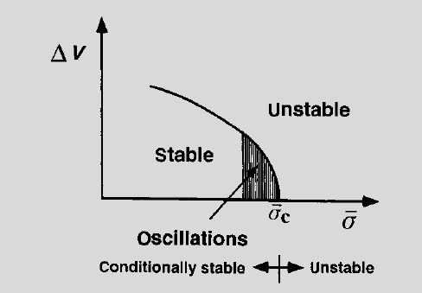
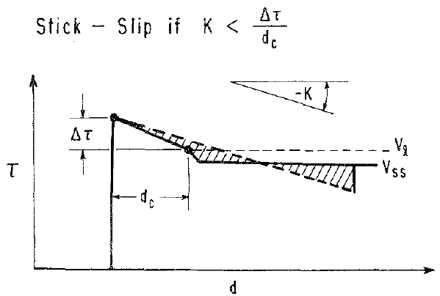
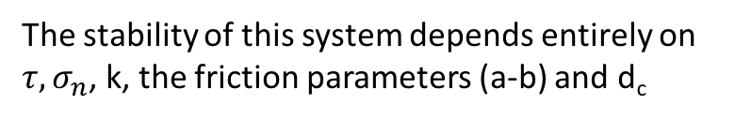
Stable Sliding and Stick-slip Transition
The stability of this system depends entirely on $τ, σ_{n}$, k, the friction parameters (a-b) and d_{c}
K
∆μ=A[log(Bt+1)-log(Bd_{c}/V_{l}+1)]
∆τ=∆μ * C_σ_{n}
K=∆τ/d_{c}
C_σ_{n}=K * d_{c/}∆μ
self-sustaining
oscillatory motion
V_{l}
(Scholz 1998)
(Dieterich 1978)
Notes:
Stick-slip of a one-dimensional slider with time- and velocity-dependent friction. The solid line gives the variation of friction with displacement. The dashed line gives the force-displacement path of the spring. Unstable slip occurs because the force exerted by the spring exceeds the frictional resistance.

Slide 9
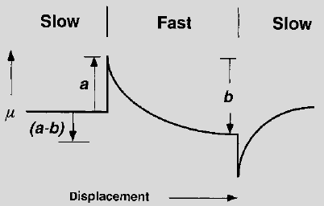
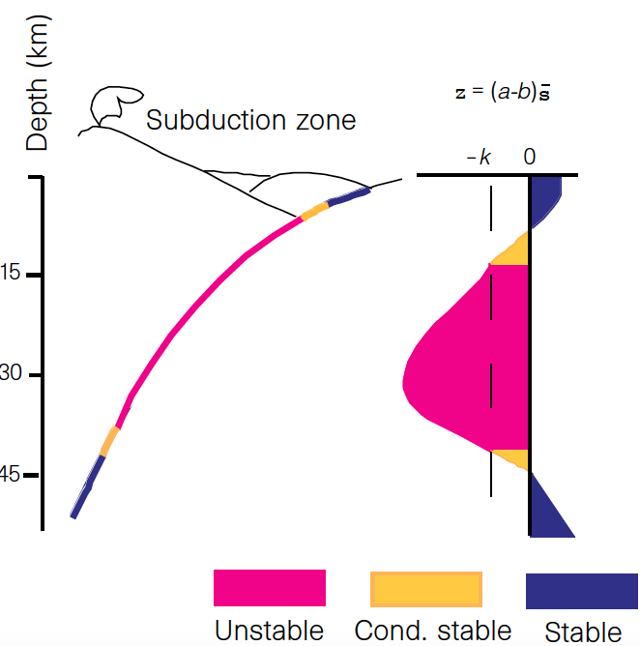
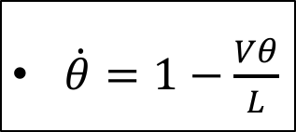
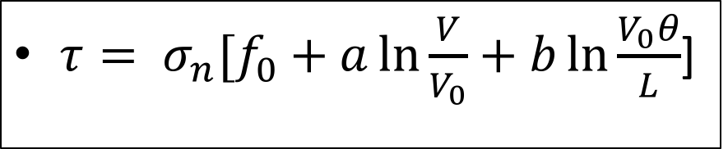
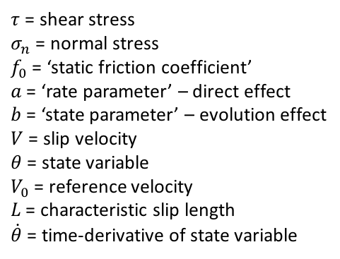
What is rate-and-state friction??
$τ= σ_{n}[f_{0}+a\ln{\frac{V}{V_{0}}+b\ln{\frac{V_{0}θ}{L}}}$]
$\dot{θ}=1−\frac{Vθ}{L}$
L
$τ$ = shear stress
$σ_{n}$ = normal stress
$f_{0}$ = ‘static friction coefficient’
$a$ = ‘rate parameter’ – direct effect
$b$ = ‘state parameter’ – evolution effect
$V$ = slip velocity
$θ$ = state variable
$V_{0}$ = reference velocity
$L$ = characteristic slip length
$\dot{θ}$ = time-derivative of state variable
(a – b) > 0: velocity-strengthening
(a – b) = 0: velocity-neutral
(a – b) < 0: velocity-weakening
Scholz, 1998

Slide 10
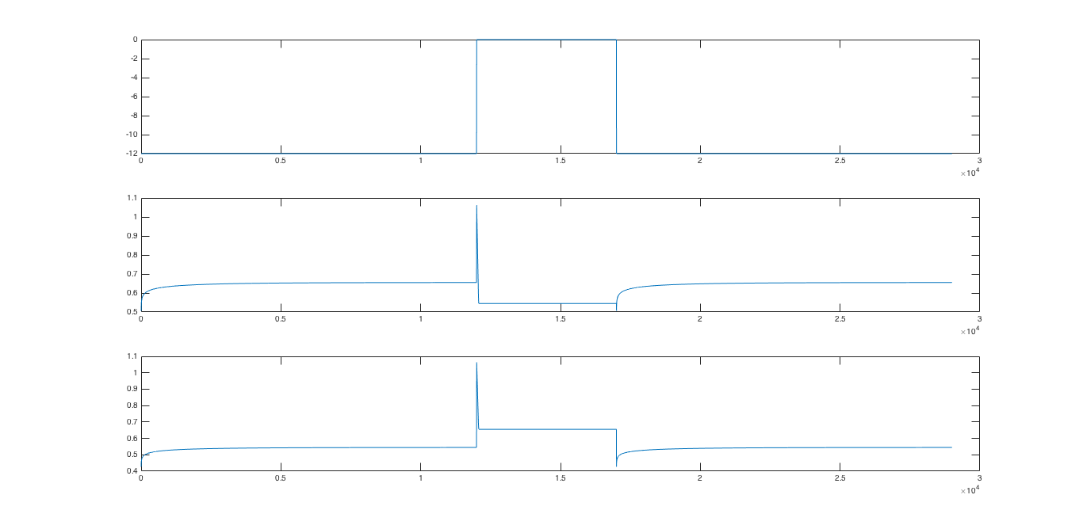
slow
fast
slow
weakening
strengthening

Slide 11
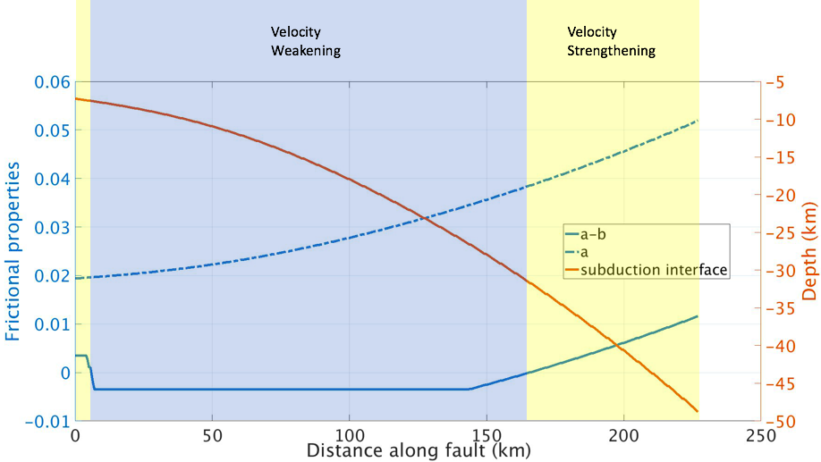
Subducted Seamounts, 1D RS test
Temperature (ºC) | a – b
118 | 0.0035
120 | -0.0035
416 | -0.0035
520 | 0.001
Tong and Lavier, in prep.

Slide 12
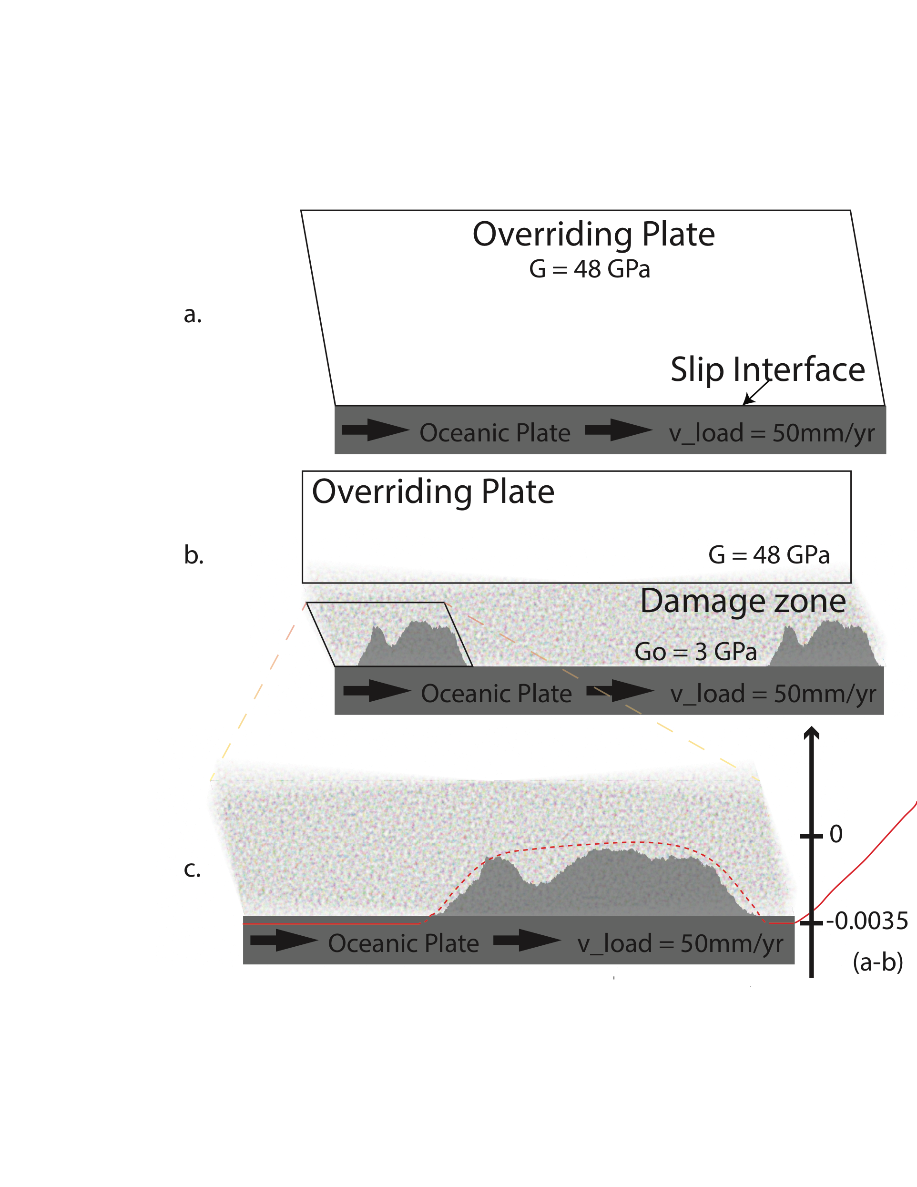
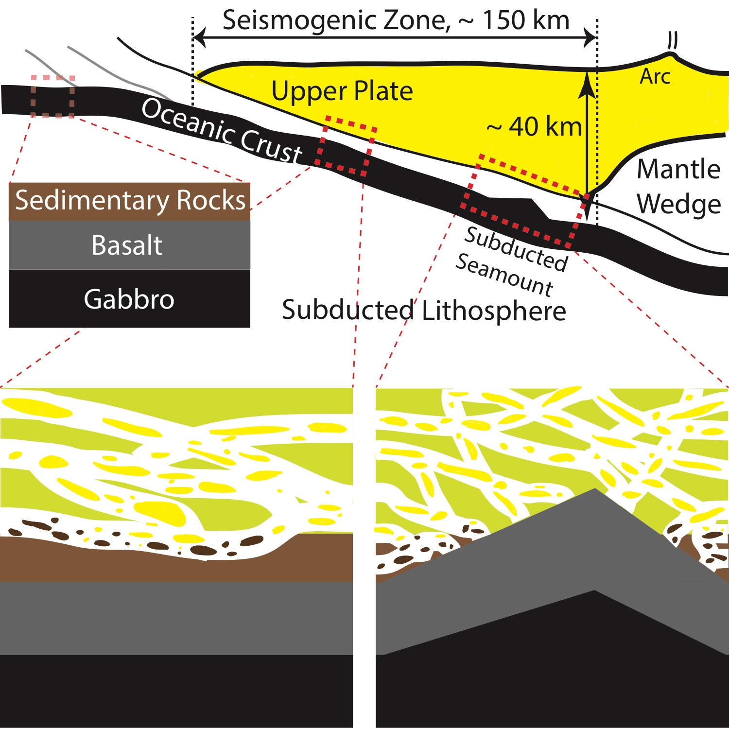
Subducted Seamounts, 1D RS test
Tong and Lavier, in prep.
Damage Zone Shear Modulus (GPa) | Loading Zone Thickness (km) | a-b in velocity-weakening zone | Earthquake Recurrence (yr) | Mean Coseismic slip (m) | Averaged Earthquake Magnitude (Mw)
48 | 20 | -0.0035 | 43.6 | 2.24 | 7.8
12 | 20 | -0.0035 | 121 | 6.05 | 8.1
3 | 20 | -0.0035 | 285 | 12.27 | 8.3

Slide 13
Tong and Lavier, in prep.

Slide 14
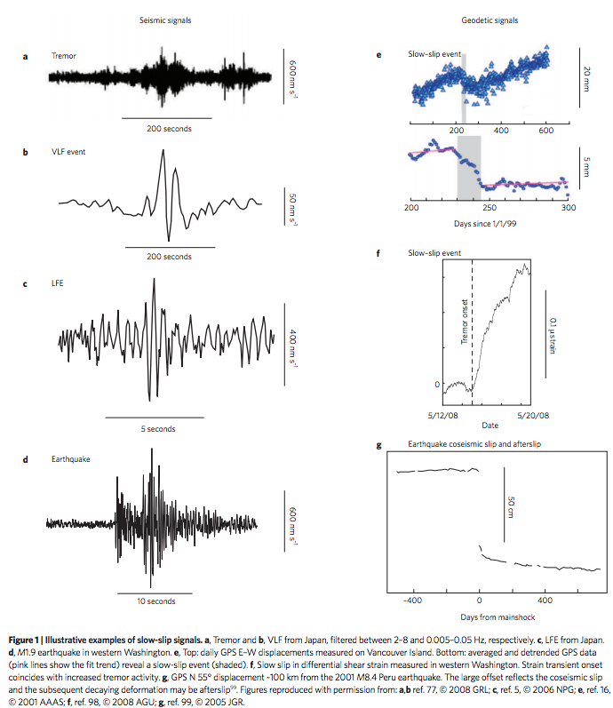
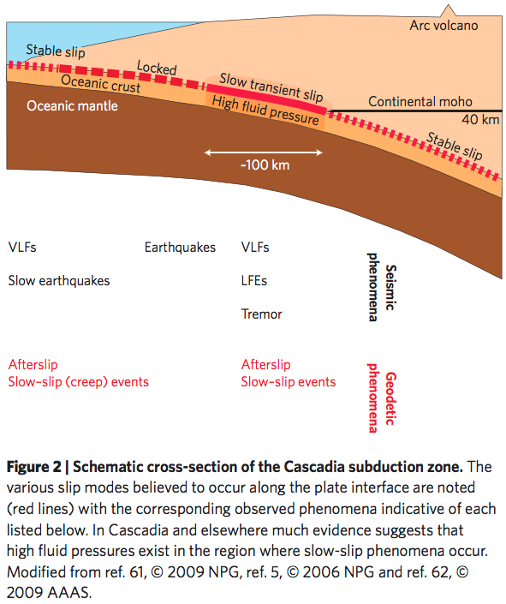
Different Slip Behaviors
Peng and Gomberg, 2010

Slide 15
Different Slip Behaviors
Peng and Gomberg, 2010

Slide 16
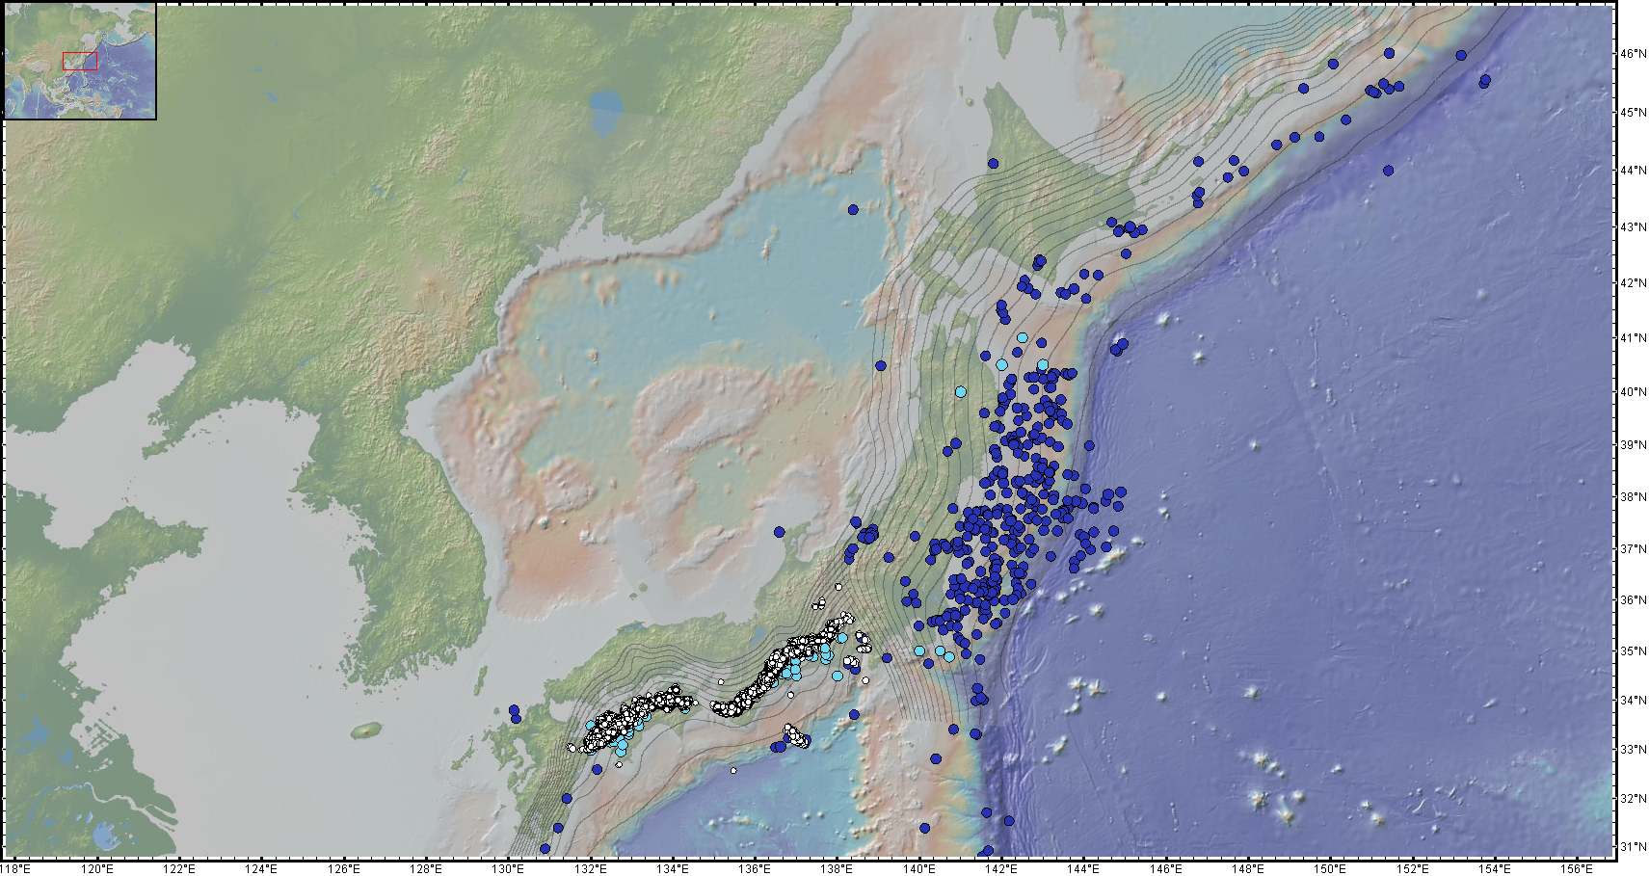
Japan
From April, 2004 to March, 2013
Earthquakes
Slow Slip Events
Tremors

Slide 17
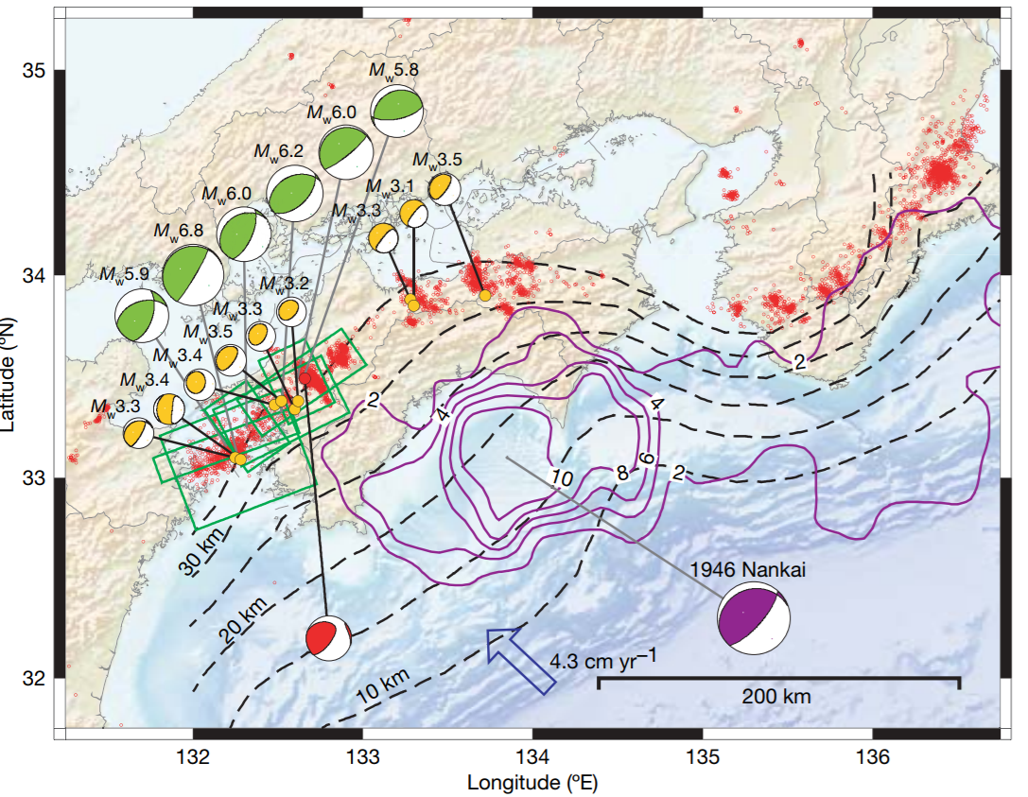
Ide et al., 2007

Slide 18
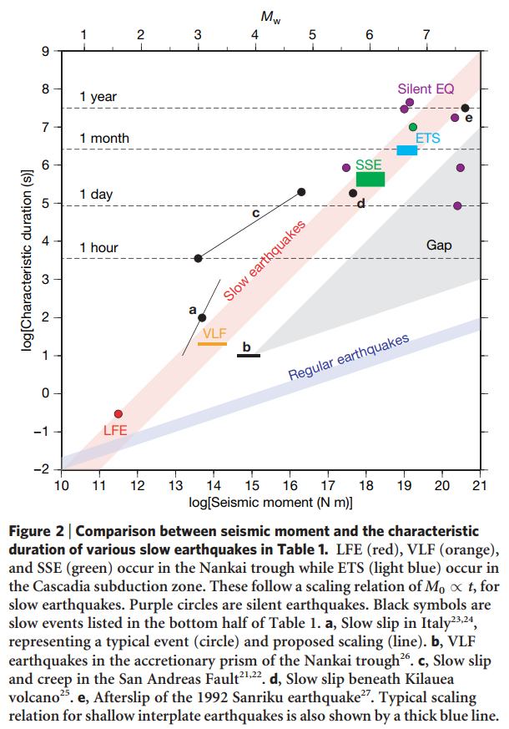
M₀ = T * 10¹²⁻¹³
The ‘beach balls’ show that this entire range of the phenomena represents shear slip on the plate interface.
Many different slow-slip phenomena might be aspects of the same process, and so follow a single scaling law
And, there is a gap
M₀ = T³ * 10¹⁵⁻¹⁶
Ide et al., 2007

Slide 19
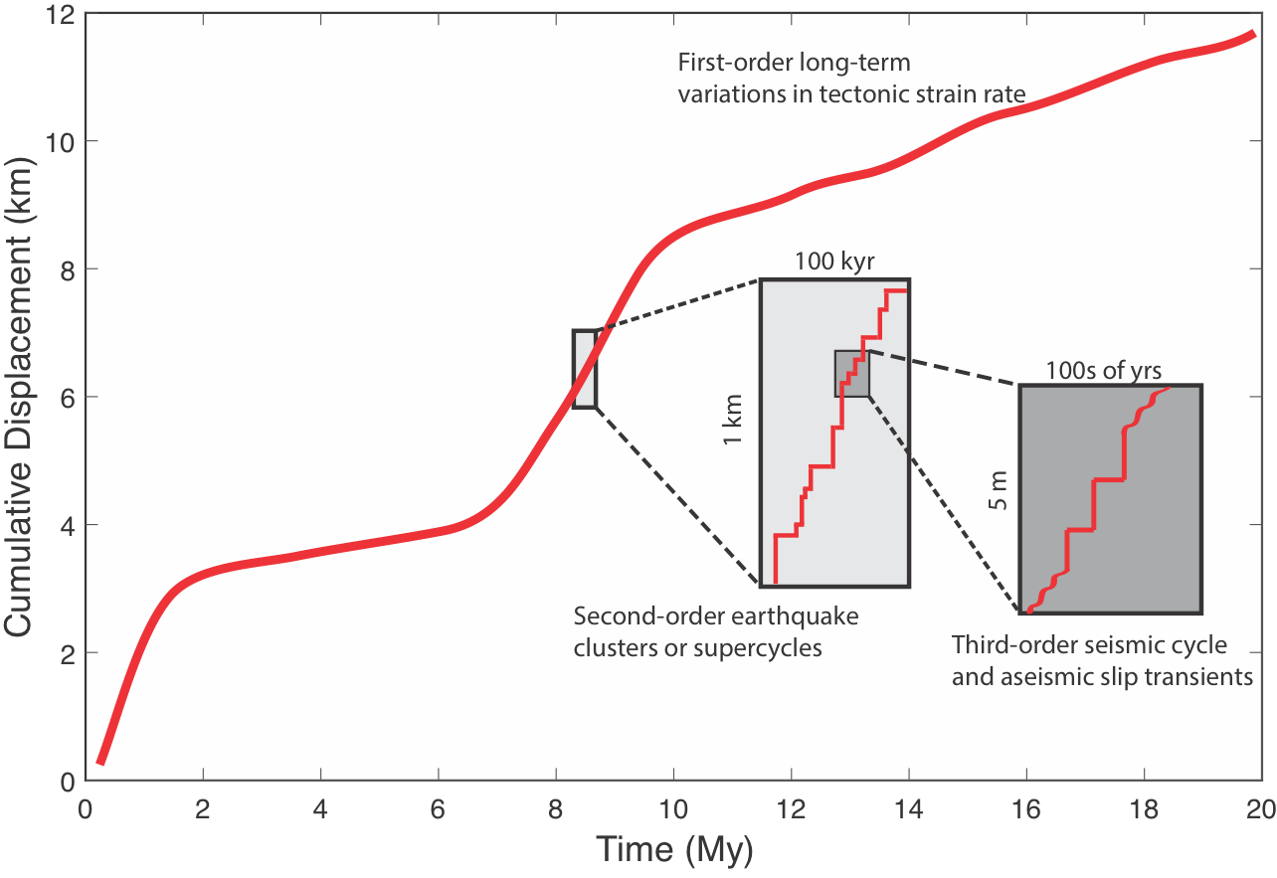
Goal: Numerical models of multi earthquake-cycle scenarios which across different timescale, use visco-elasto-plastic rheology, and incorporate rate and state friction.
Drawn after Friedrich et al., 2003.
By Biemiller, James

Slide 20
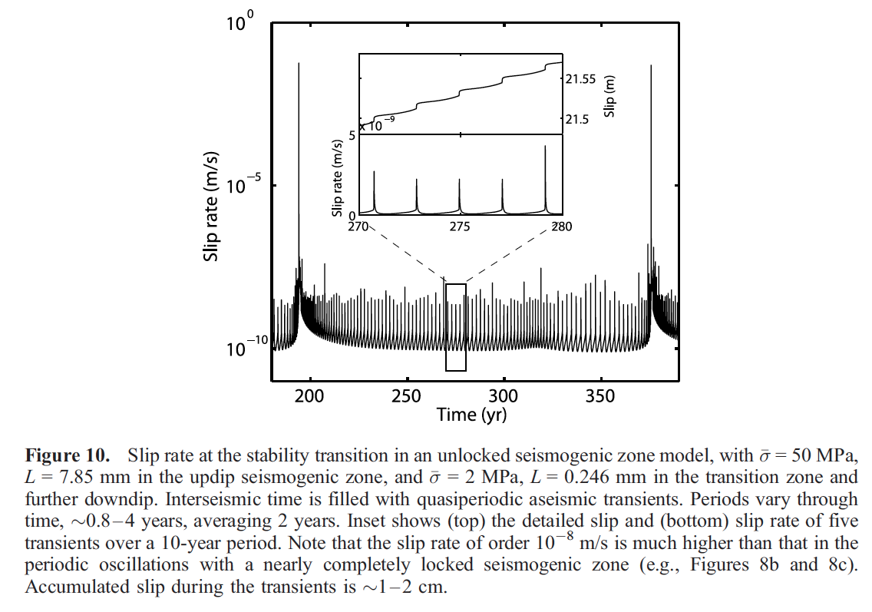
Different Slip Behaviors
Liu and Rice, 2007

Slide 21
What is rate-and-state friction??
$τ= σ_{n}[f_{0}+a\ln{\frac{V}{V_{0}}+b\ln{\frac{V_{0}θ}{L}}}$]
$\dot{θ}=1−\frac{Vθ}{L}$
L
$τ$ = shear stress
$σ_{n}$ = normal stress
$f_{0}$ = ‘static friction coefficient’
$a$ = ‘rate parameter’ – direct effect
$b$ = ‘state parameter’ – evolution effect
$V$ = slip velocity
$θ$ = state variable
$V_{0}$ = reference velocity
$L$ = characteristic slip length
$\dot{θ}$ = time-derivative of state variable
(a – b) > 0: velocity-strengthening
(a – b) = 0: velocity-neutral
(a – b) < 0: velocity-weakening
Scholz, 1998

Slide 22
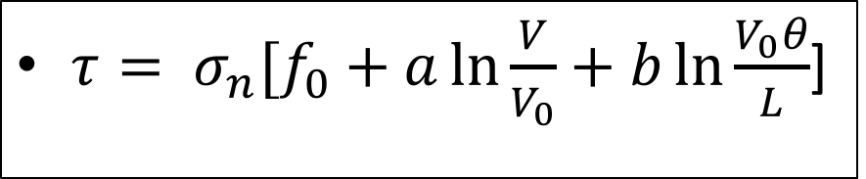
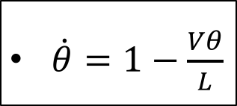
Implementation of Rate and State in to DynEarthSol
$τ= σ_{n}[f_{0}+a\ln{\frac{V}{V_{0}}+b\ln{\frac{V_{0}θ}{L}}}$]
L
$\dot{θ}=1−\frac{Vθ}{L}$
$τ$ = shear stress
$σ_{n}$ = normal stress
$f_{0}$ = ‘static friction coefficient’
$a$ = ‘rate parameter’ – direct effect
$b$ = ‘state parameter’ – evolution effect
$V$ = slip velocity
$θ$ = state variable
$V_{0}$ = reference velocity
$L$ = characteristic slip length
$\dot{θ}$ = time-derivative of state variable
(a – b) > 0: velocity-strengthening
(a – b) = 0: velocity-neutral
(a – b) < 0: velocity-weakening
Scholz, 1998

Slide 23
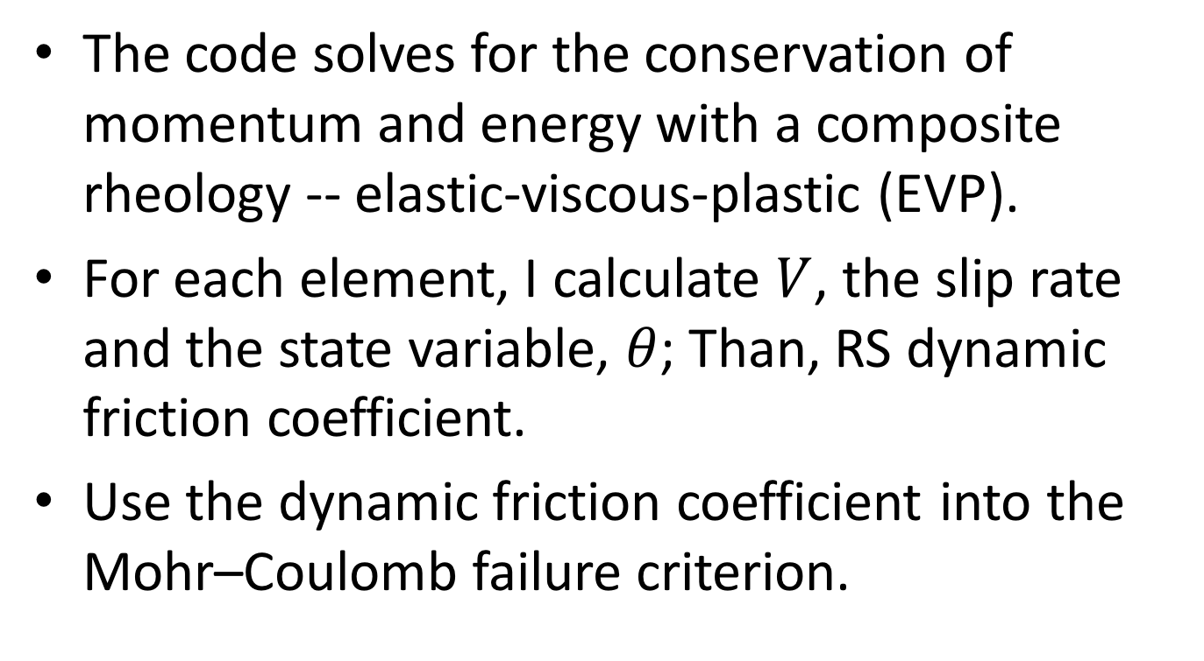
Implementation of Rate and State in to DynEarthSol
The code solves for the conservation of momentum and energy with a composite rheology -- elastic-viscous-plastic (EVP).
For each element, I calculate $V$, the slip rate and the state variable, $θ$; Than, RS dynamic friction coefficient.
Use the dynamic friction coefficient into the Mohr–Coulomb failure criterion.

Slide 24
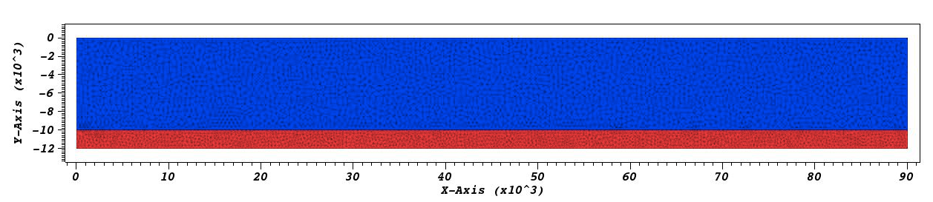
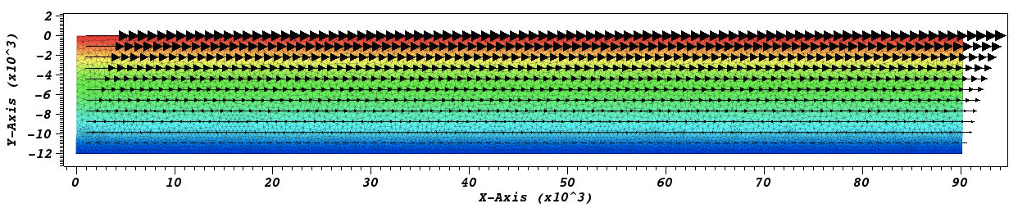
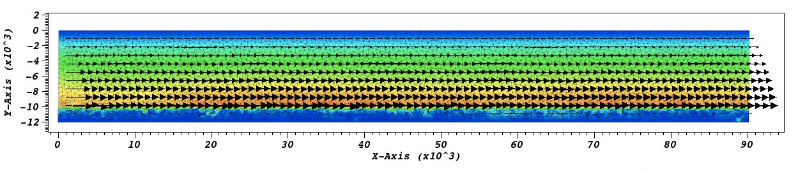
2D Test (R&S Friction): Earthquake Cycle
Loading on the top, 50 mm/yr
Elastic Upperplate
Elasto-plastic Shear Zone, rate and state dependent friction, velocity weakening
Interseismic Loading
Coseismic Slip
In prep.

Slide 25
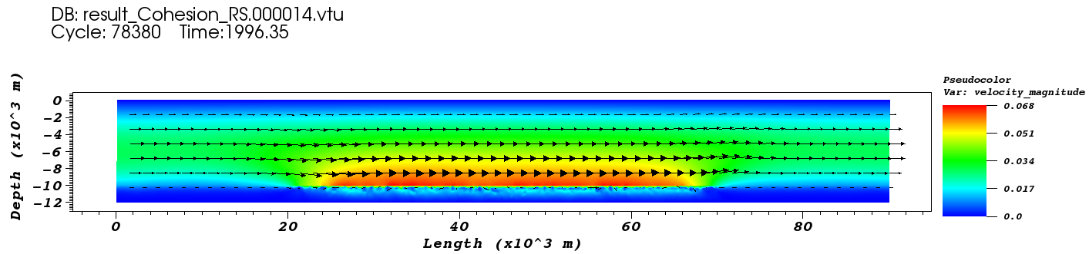
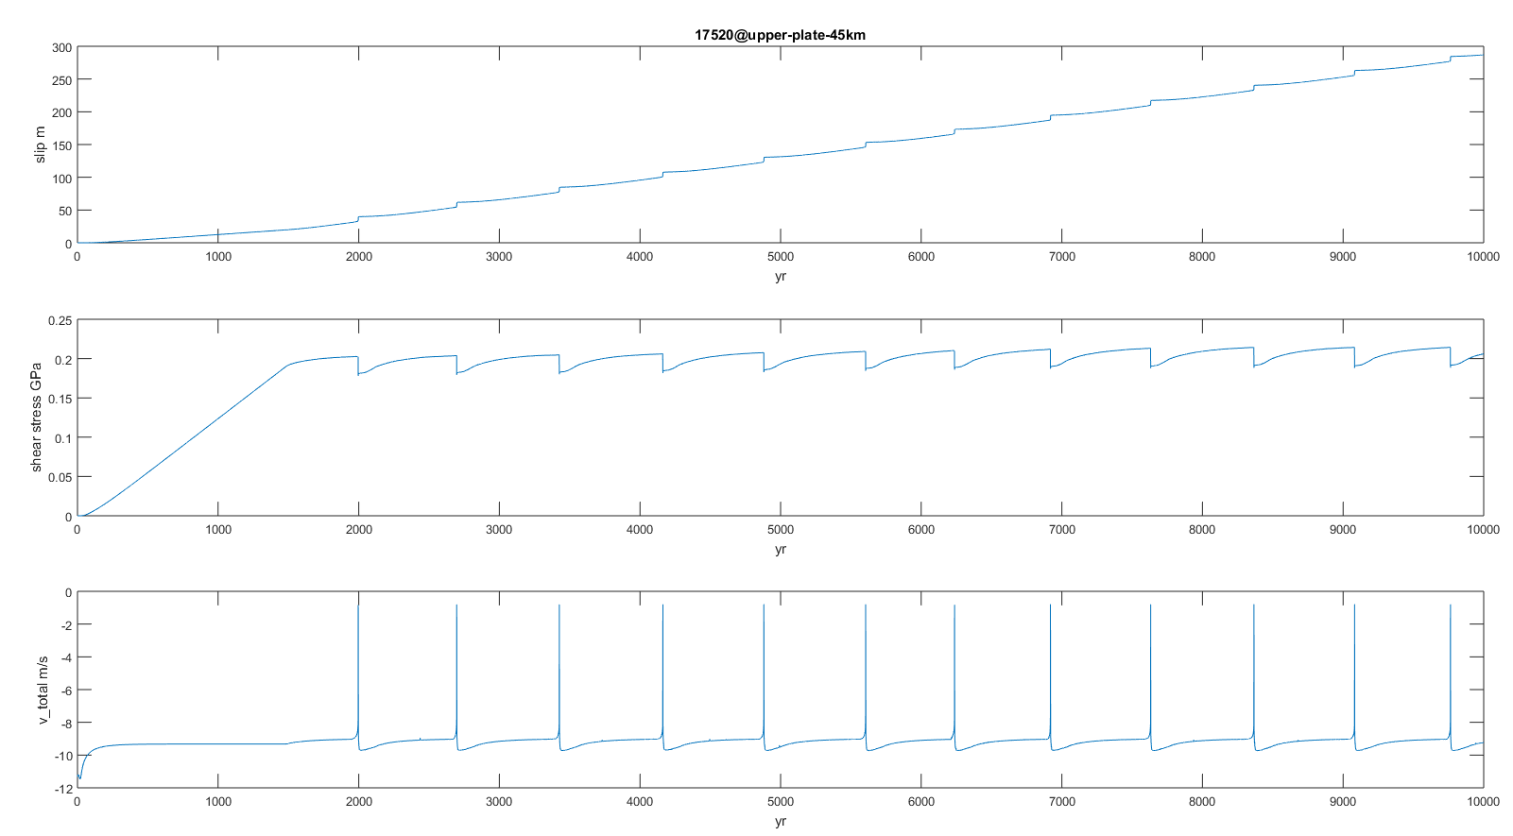

Slide 26
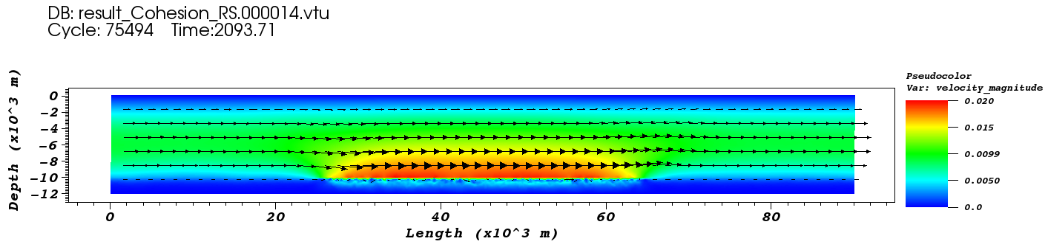
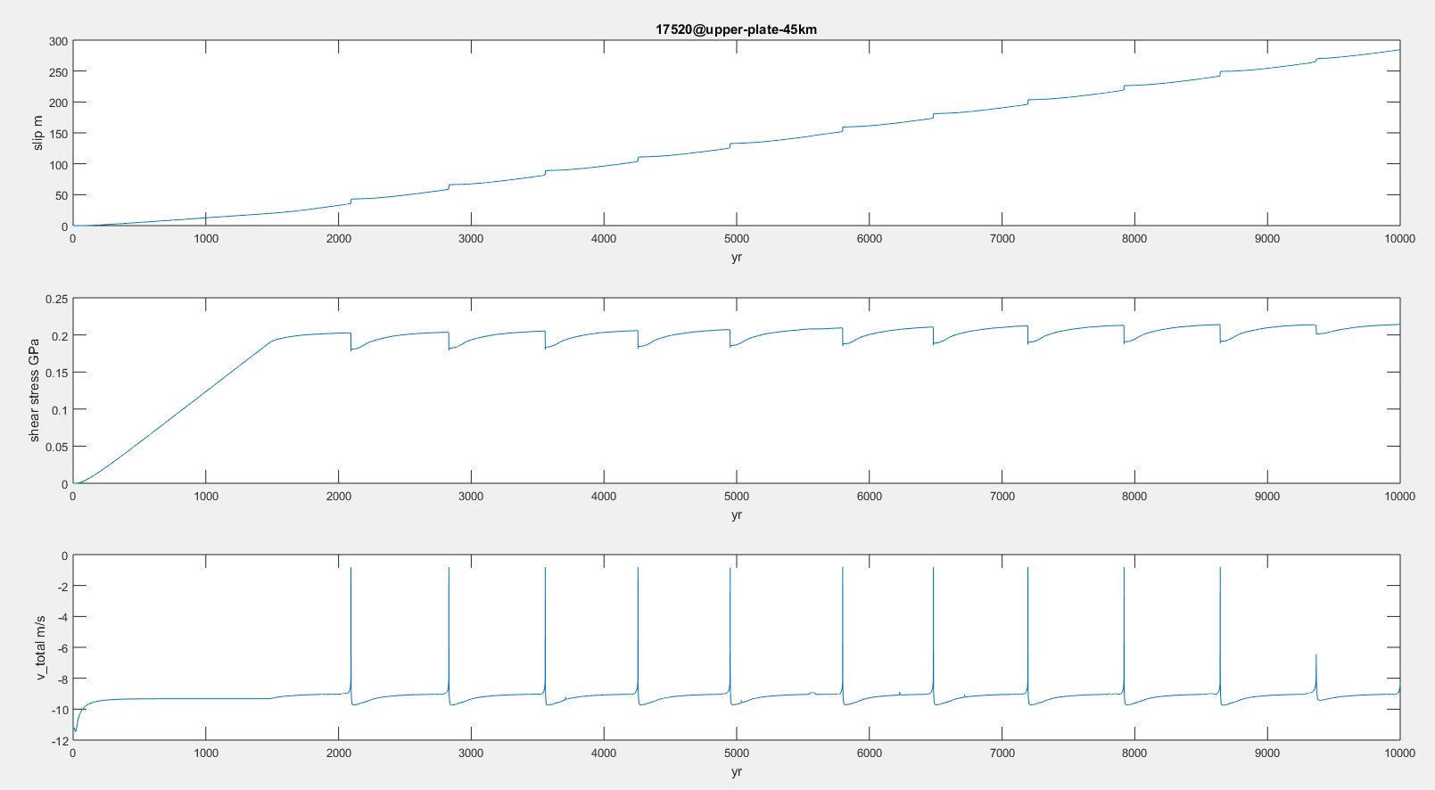

Slide 27
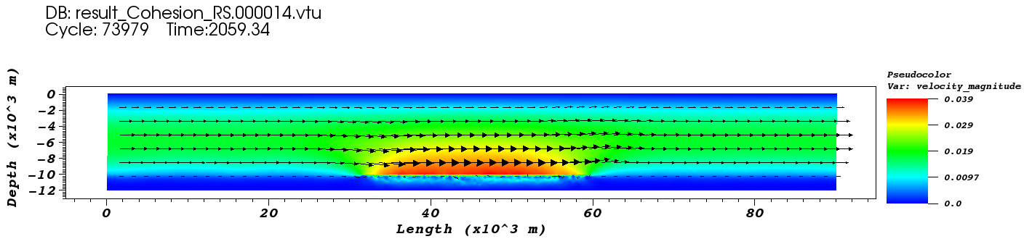
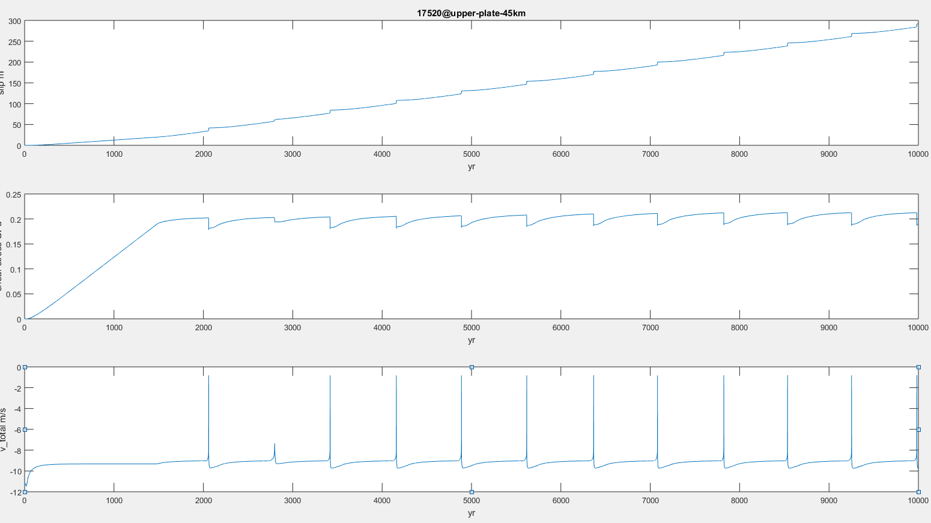

Slide 28
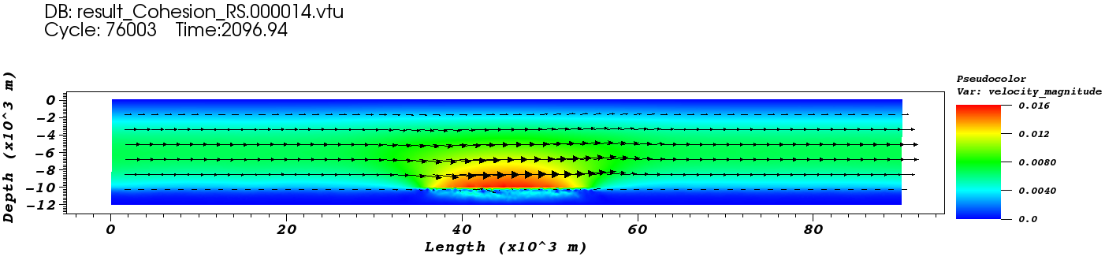
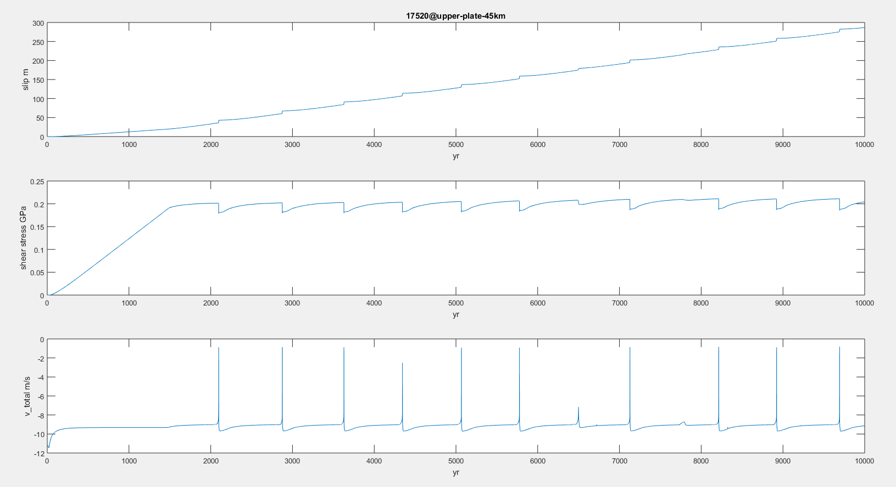

Slide 29
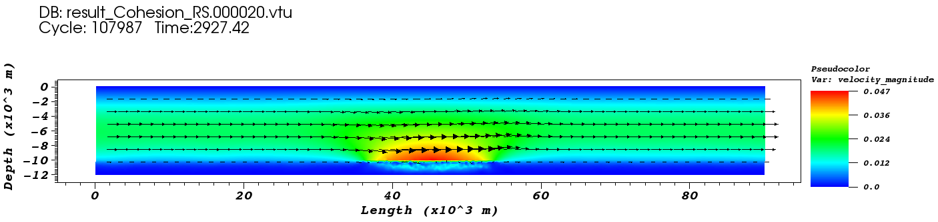
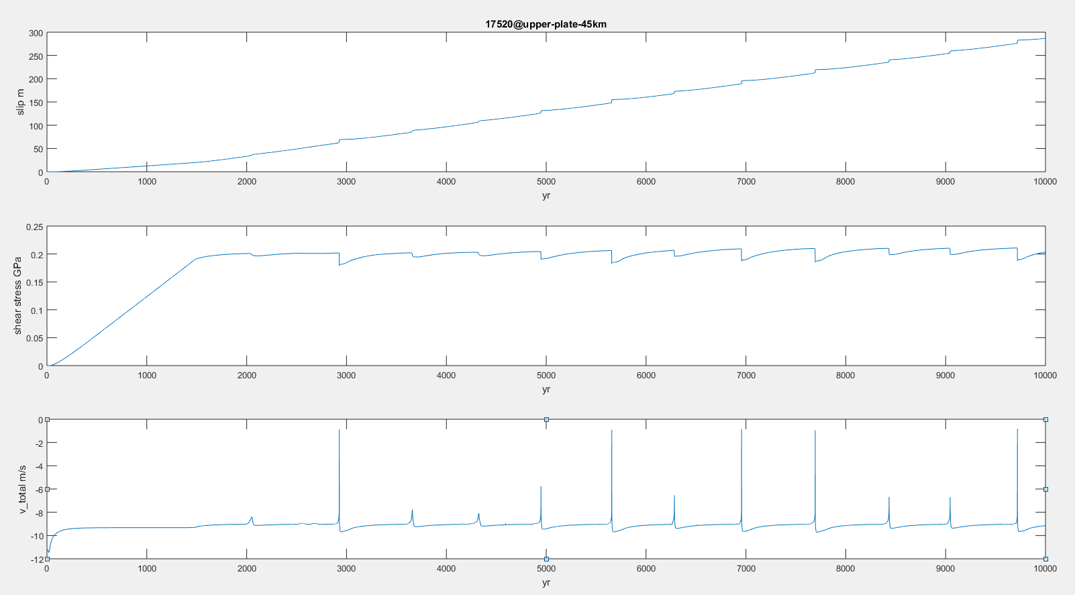

Slide 30
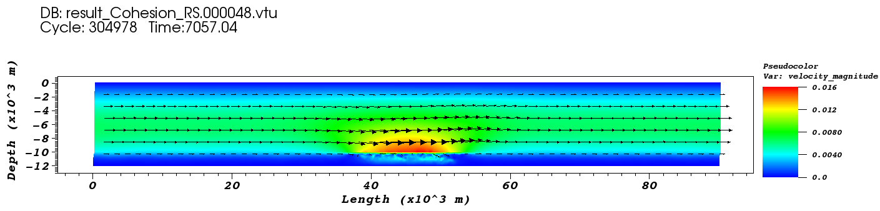
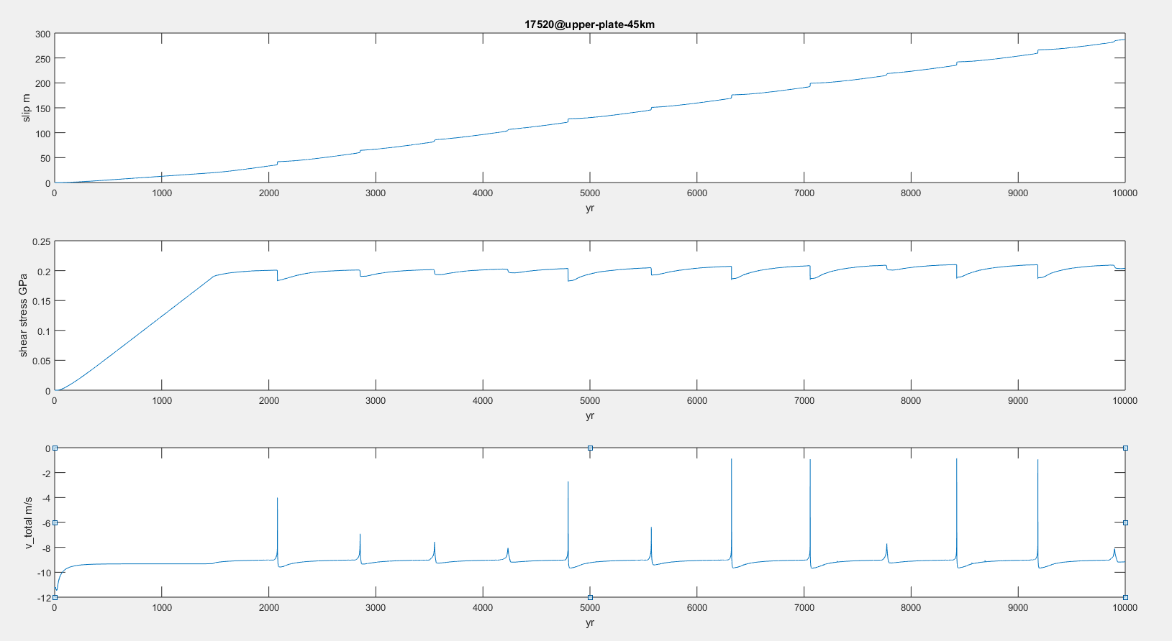

Slide 31
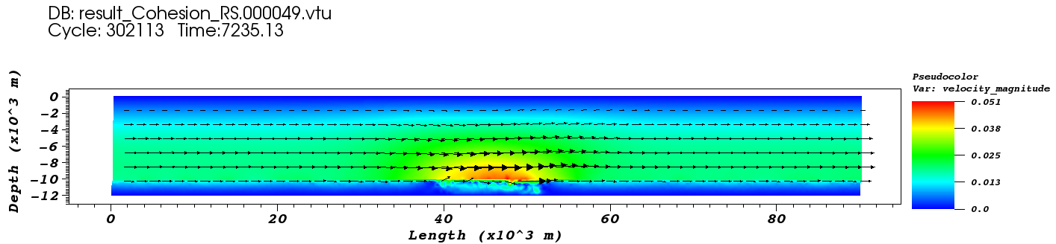
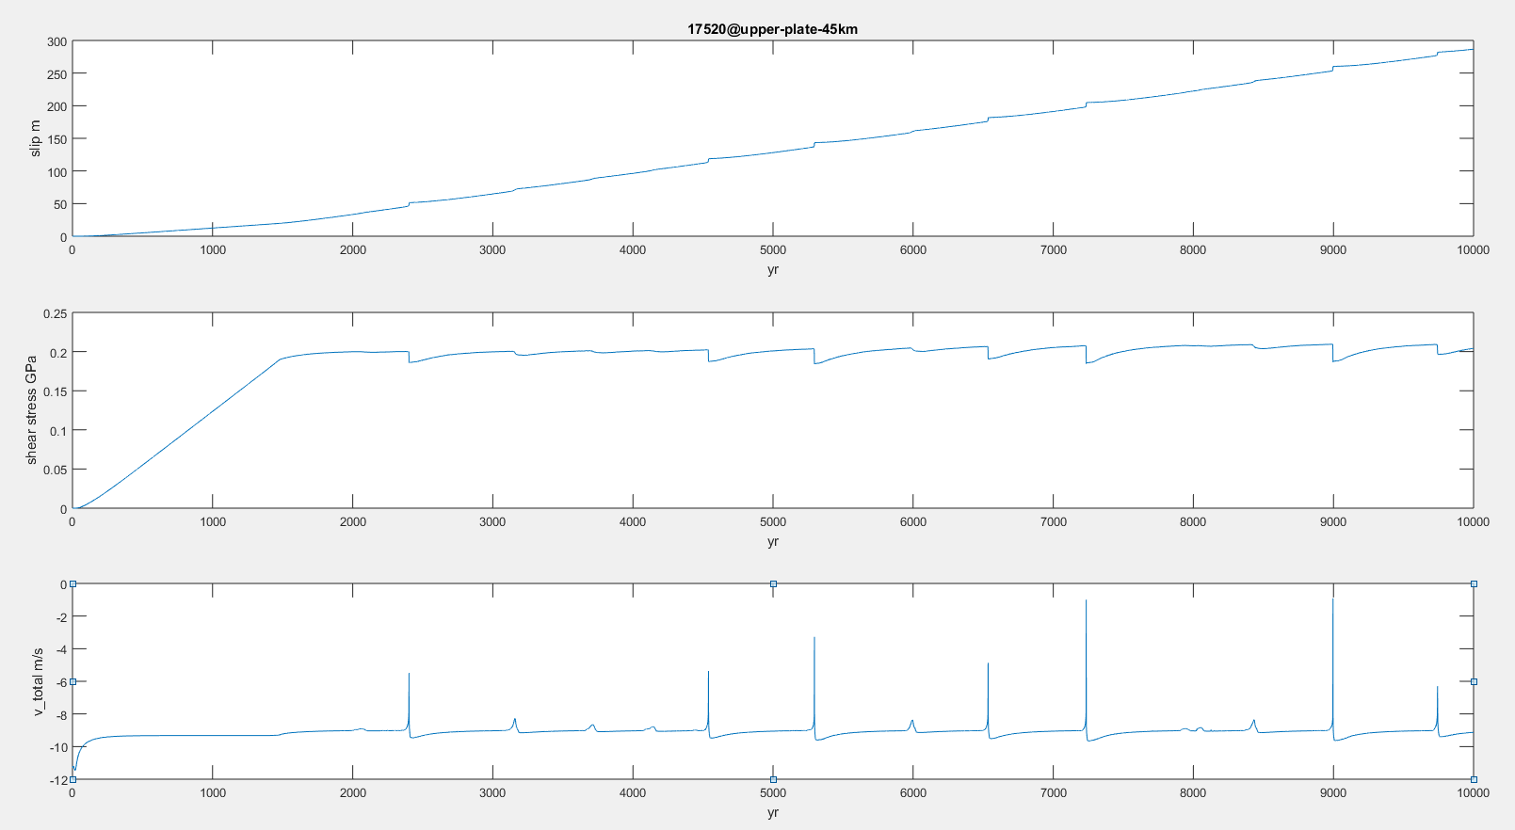

Slide 32
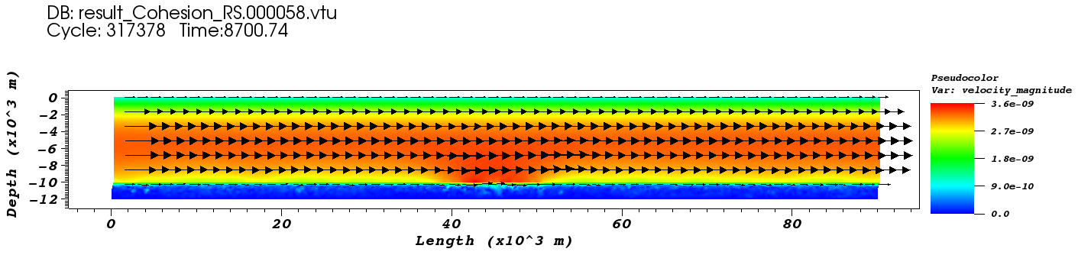
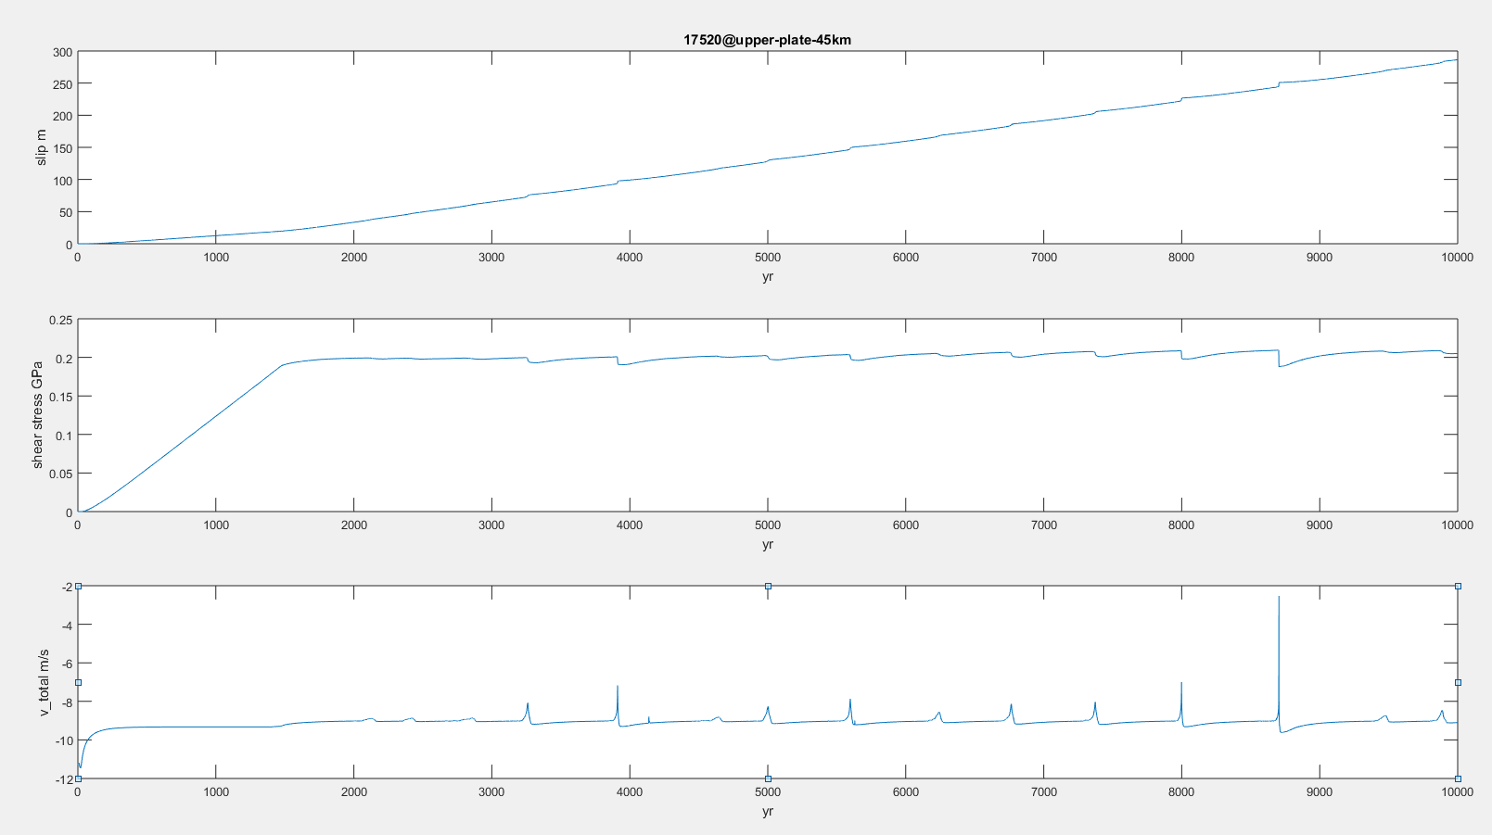

Slide 33
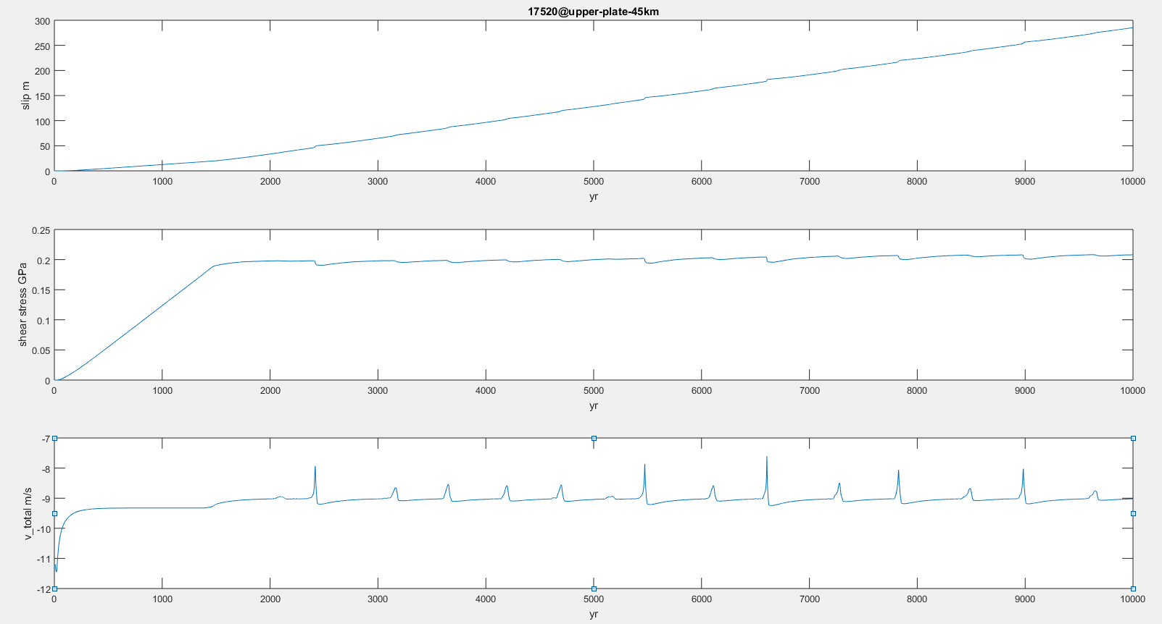

Slide 34
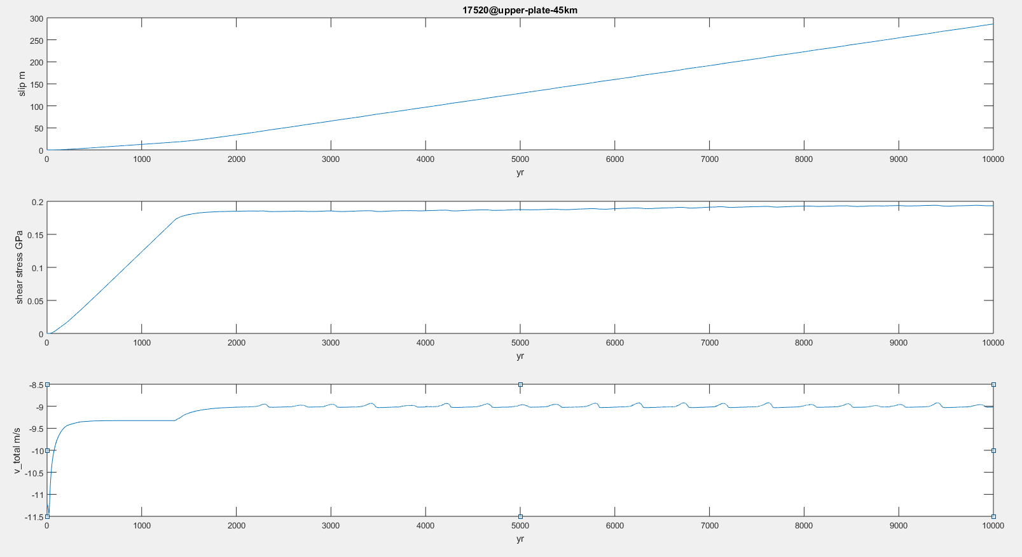

Slide 35
M₀ = T * 10¹²⁻¹³
M₀ = T³ * 10¹⁵⁻¹⁶
Decrease <a-b>, fast EQs -> slow EQs

Slide 36
2D Test (Semi-Brittle): Earthquake Cycle
Loading on the top, 50 mm/yr
Elastic Upperplate
Elasto-plastic Shear Zone, rate and state dependent friction, velocity weakening
Interseismic Loading
Coseismic Slip
In prep.

Slide 37



2D Test (Semi-Brittle): Earthquake Cycle
Loading on the top, 50 mm/yr
Elastic Upperplate
Elasto-plastic Shear Zone, rate and state dependent friction, velocity weakening
Aseismic Slips
Coseismic Slips
In prep.

Slide 38
2D Application: Japan
From April, 2004 to March, 2013
Earthquakes
Slow Slip Events
Tremors
On going work

Slide 39
2D Application: Japan
From April, 2004 to March, 2013
Earthquakes
Slow Slip Events
Tremors
Old, Cold
~ 80 mm/yr
Young, Warm
~ 50 mm/yr
On going work

Slide 40

2D Application: Japan
From April, 2004 to March, 2013
Earthquakes
Slow Slip Events
Tremors
From April, 2004 to March, 2013
Earthquakes
Slow Slip Events
Tremors
Old, Cold
~ 80 mm/yr
Young, Warm
~ 50 mm/yr
On going work

Slide 41


Slide 42


Slide 43



Slide 44
Conclusions
1D Rate and State Dependent Friction Test: Earthquake Cycles and Different Slip Behaviors
2D R&S and Semi-Brittle Test: Brittle and Ductile Mixture and Composite Rheology
Northeast Japan vs. Southwest Japan
Questions? Comments? Suggestions? Opportunities?

Slide 45
Loading on the top, 50 mm/yr
Elastic Upperplate
Semi-Brittle Shear Zone, rate and state dependent friction
Aseismic Slips
Coseismic Slips

